Slide 1
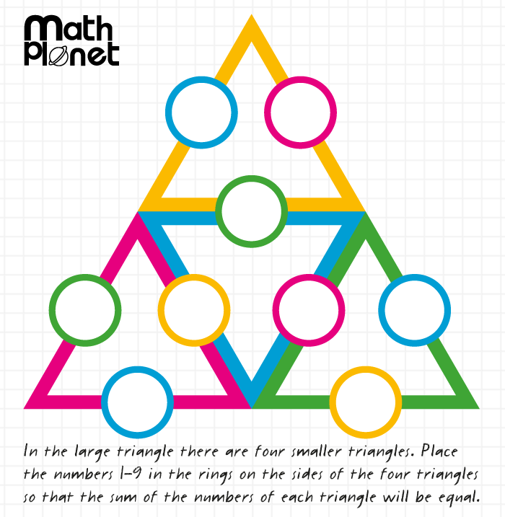
Topic: Pythagoras Theorem EQ: What is the Pythagoras Theorem?
Solve(on LHS)
Steps to be successful this lesson:
Get materials out (notebook, pen, pencil, ruler, scientific calculator)
Rule up notebook and write Topic and EQ
Start on review questions →
Check your answers with someone sitting next to you
Is your notebook up to date? (Contents page, glossary, summary, review notes etc.)

Slide 2
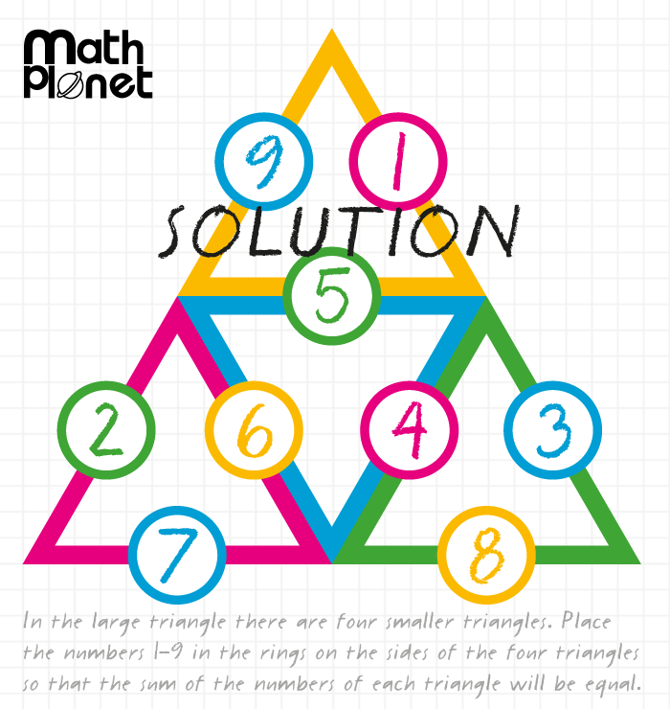
Topic: Pythagoras Theorem EQ: What is the Pythagoras Theorem?
Solve(on LHS)
Steps to be successful this lesson:
Get materials out (notebook, pen, pencil, ruler, scientific calculator)
Rule up notebook and write Topic and EQ
Start on review questions →
Check your answers with someone sitting next to you
Is your notebook up to date? (Contents page, glossary, summary, review notes etc.)

Slide 3
Pythagoras Calculating the Shorter Side
Year 10 Mathematics

Slide 4
Pythagoras Theorem
c
b
a

Slide 5
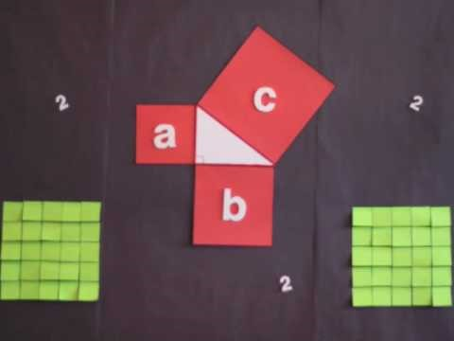
Pythagoras Theorem Video
https://www.youtube.com/watch?v=uaj0XcLtN5c

Slide 6





24
7
30
Topic: Pythagoras Theorem
Date: /06/2018
EQ – How do I calculate the shorter side of a right-angled triangle?
Pythagoras Theorem is about right angles triangles.
$$a^{2}+ b^{2}= c^{2}$$
c
a
b
Therefore to find the shorter sides:
$${ a}^{2}=c^{2}−b^{2} and b^{2}=c^{2}−a^{2}$$
$a= \sqrt{c^{2}− b^{2} }$
$$b=\sqrt{c^{2}− a^{2}}$$
$$c=\sqrt{a^{2}+ b^{2}}$$

Slide 7


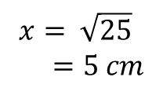
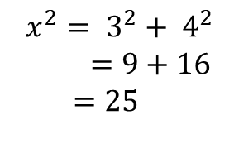

Calculating Hypotenuse
Let’s remind ourselves with how we can calculate the length of the hypotenuse of a right-angled triangle.
$$x^{2}= 3^{2}+ 4^{2}$$
$=9+16$
$$=25$$
$$x$$
$$3 cm$$
$$x= \sqrt{25}$$
$=5 cm$
$$4 cm$$

Slide 8





24
7
30
Topic: Pythagoras Theorem
Date: /06/2018
EQ – How do I calculate the shorter side of a right-angled triangle?
shorter side
$$x^{2}= {20.4}^{2}− {9.6}^{2}$$
$=416.16−92.16$
$$=324$$
$$9.6 cm$$
$$x$$
$$x= \sqrt{324}$$
$=18 cm$
$$20.4 cm$$
hypotenuse

Slide 9


Slide 10

We Do
Determine the length of the unknown side of this right-angled triangle.
$$e^{2}=f^{2}−d^{2}$$
$$e^{2}={10}^{2}−8^{2}$$
$$f^{2}=100−64$$
$$f^{2}=36$$
$$f=\sqrt{36}$$
$f=6$ cm
d = 8 m
e
f = 10 m

Slide 11
Task
Excel Worksheets
Finding the Length of a Side
Miscellaneous Questions
Notes:
Dark hair, not dark hair
Short hair, long hair
Alternatives: boy / girl, shorts/pants

